Slide 1
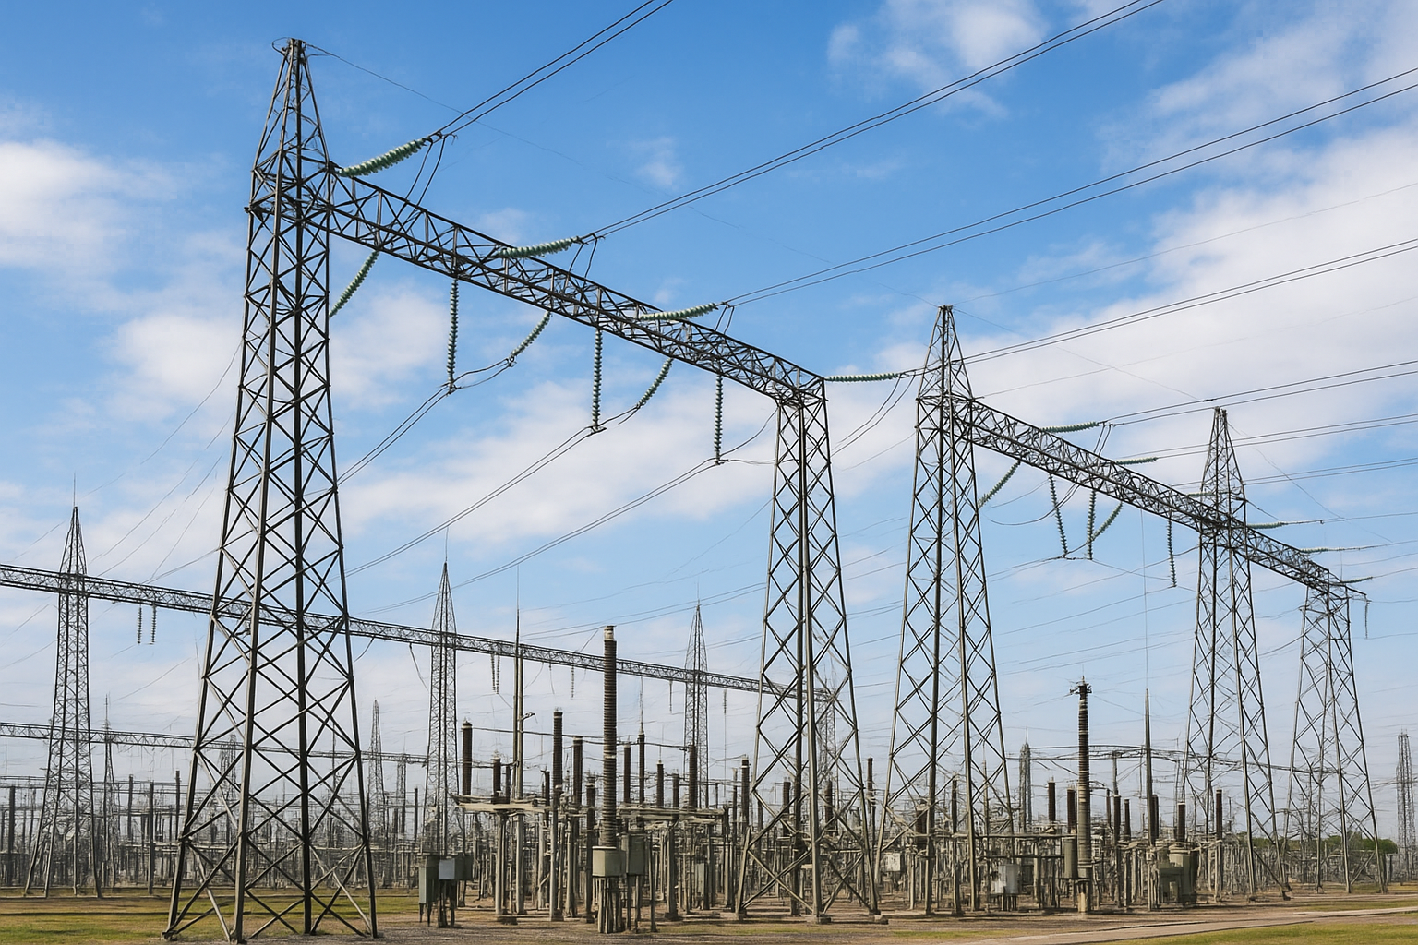
Nigeria Electricity System Analysis (2000–2024)
Trends, Emissions, Renewable Share & Decarbonization Outlook
Prepared by: Suleiman Taiwo – Energy Data & Metering Analyst
Date: December 2025

Slide 2
Executive Summary
Nigeria’s electricity sector is becoming more fossil-heavy, less renewable, and more carbon-intensive. This analysis evaluates two decades of data (2000-2024) to understand whether Nigeria is on track with her Energy Transition Plan (ETP) TOWARDS 82% renewables and 277 GW installed capacity by 2060
Renewable Energy
Renewable share dropped from 38% → 23%
(2000–2024),
while fossil share increased from 62% → 77%.
Electricity carbon intensity
Electricity carbon intensity remains relatively high, contributing significantly to national GHG emissions.
Net decarbonization index
Decarbonization index declined from –23% → –60%, reflecting accelerated dependency on gas-based generation.
To meet the Nigeria Energy Transition Plan (ETP) pathway, Nigeria must rapidly scale renewable capacity, expand grid infrastructure, and accelerate investment into clean energy, storage, and hydrogen.

Slide 3


CONTEXT & PURPOSE
Why this analysis matters
Nigeria’s electricity sector faces three strategic challenges:
1. Increase Fossil Dependance
Fossil share rising instead of falling (2000-2024).
2. Declining Renewable Share
Hydro and other renewables not growing fast enough.
3. High and Variable Carbon Intensity
Carbon intensity remains above 500–550 gCO₂/kWh, raising electricity emissions.
These trends conflict with the ETP’s target of 82% renewable capacity by 2050 and a 6.5× increase in electricity generation by 2060

Slide 4
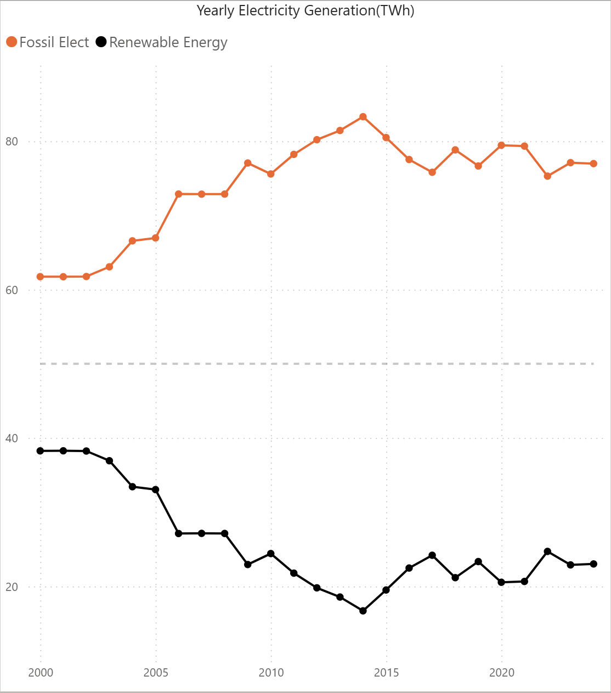
Electricity MIX TREND
Renewables ↓ Fossils ↑ (2000–2024)
Fossil sources account for over 80% of total generation
Limited progress toward solar and hydro targets outlined in Nigeria’s Energy Transition Plan.

Slide 5
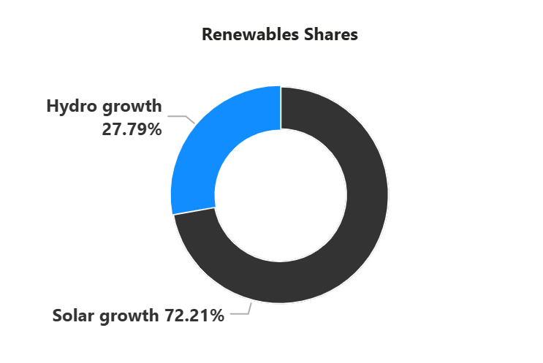
Renewable Category
Hydro growth has remain stagnant
With no significant new capacity in two decades.

Slide 6
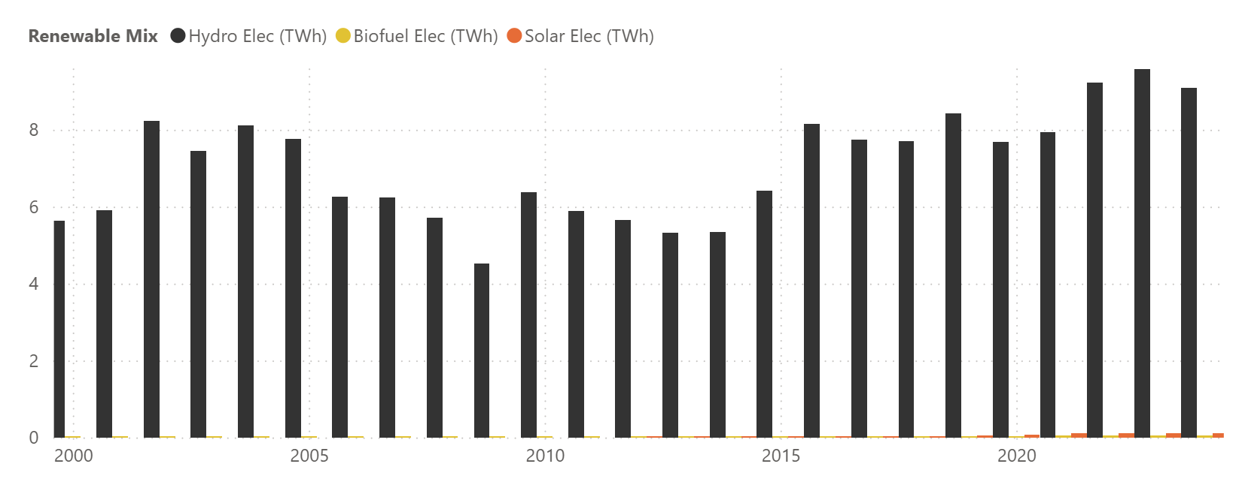
Renewable Mix
Hydro remains the only major renewable.
Solar/wind adoption at grid-scale remains negligible.

Slide 7
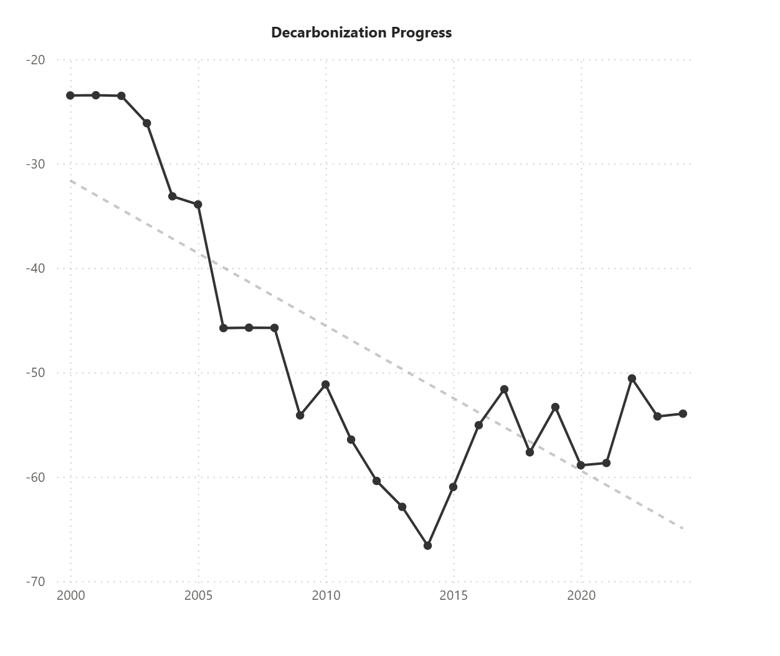
Decarbonization Index
Nigeria is moving in the opposite direction of global trends
Between 2000 and 2024, Nigeria’s electricity mix shifted
heavily toward fossil fuels, producing a DECARBONIZATION
chart trend that shows a steady deepening decline
(–23% to –53%).

Slide 8
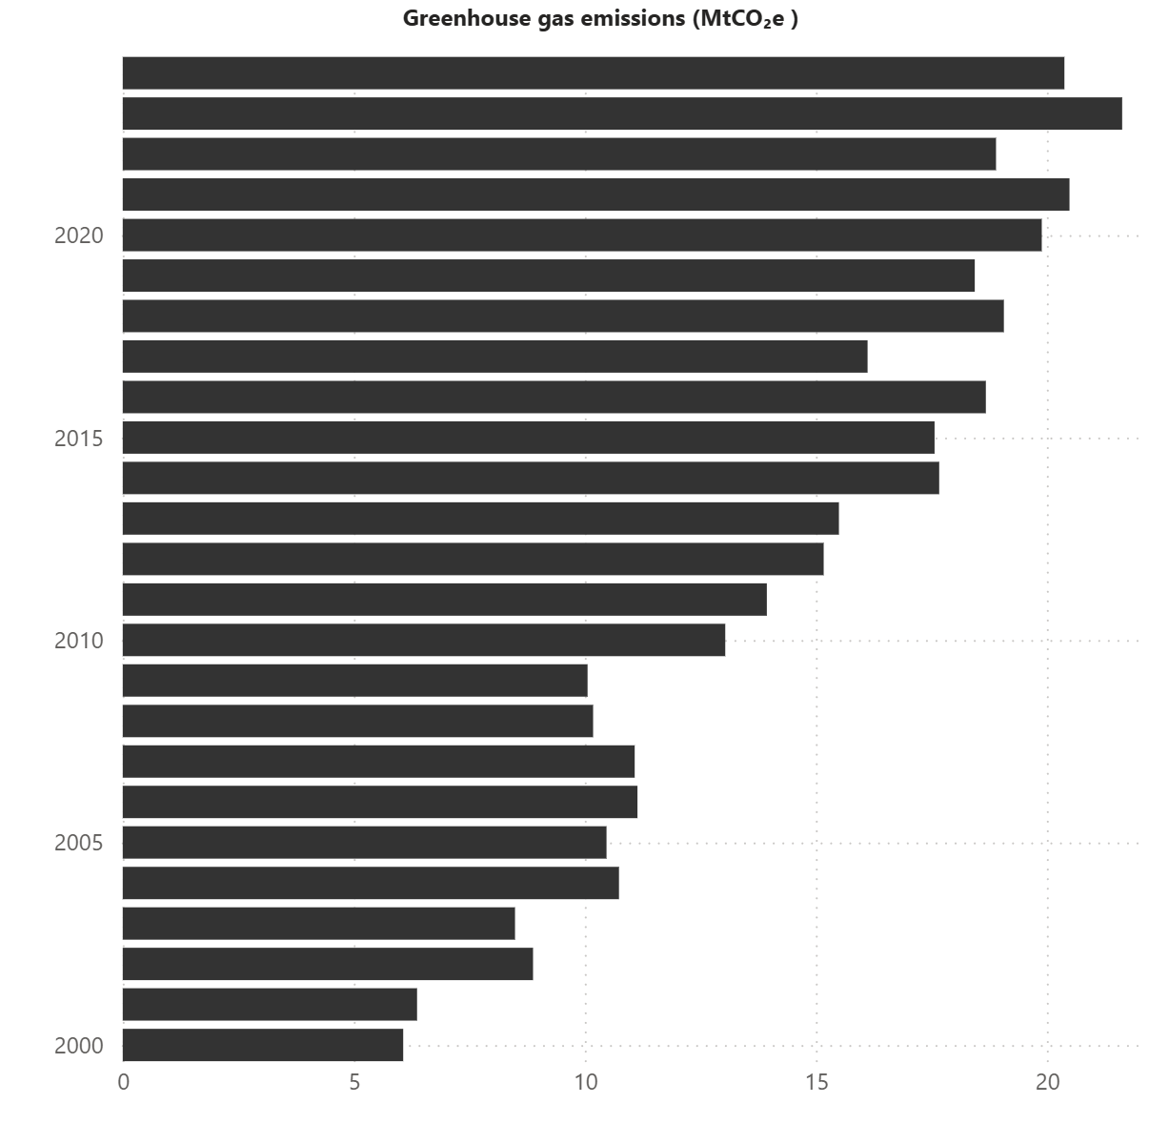
GreenHouse Gas Emission
A steady climb in GreenHouse Gas emission going in opposite direction of global trend

Slide 9

2024 Reality Check
Metric | Nigeria 2024 | ETP Target | Gap
Renewable share | 23 % | 82 % by 2050 | −59 %
Installed capacity | ~15 GW | 277 GW by 2060 | −262 GW
Solar PV | < 2 GW | 209 GW by 2060 | −207 GW
Hydro | ~ 2 GW | 11 GW by 2060 | −9 GW
BESS Storage | ≈ 0 GW | 130 GW by 2060 | −130 GW
Hydrogen | 0 GW | 36 GW by 2060 | −36 GW
Battery Energy Storage System (BESS)

Slide 10
Recommendations
Pathways to a More Efficient Energy Future
1. Scale Up Renewables
Accelerate solar PV & hydro to reverse decline.
2. Invest in Storage & Grid Modernization
Start Deployment of BESS and Green hydrogen at national level.
3. Loss reduction
Enhance smart metering rollout to reduce losses and improve consumption tracking
4. Strengthen Policy & Finance
Nigeria has made policy, regulatory, and market strides toward a cleaner energy future, but implementation gaps remain, especially for solar, wind, and bioenergy

Slide 11
Resources and Tools
Sources
Our World in Data – Energy Dataset
Nigeria Energy Transition and Investment Plan Update (2024)
Global Practice Guides — Renewable Energy (Nigeria)
Energy 2025 Guide
Tools
Python (Pandas)
SQL (PostgreSQL)
Power BI

Slide 12
Contact
📧 Email
Suleyimantaiwo@gmail.com
🔗 LinkedIn
https://www.linkedin.com/in/suleimantaiwo/
💻 GitHub
https://github.com/SuleimanTaiwo/Nigeria-Electricity-System-Analysis.git
🌍 Portfolio Website
https://suleyimantaiwo.wixsite.com/portfolio

